Slide 1

Web app testing
Final Project
Presented by
Călinescu Andrei-Lucian
The Informal School of IT

Slide 2


What is ?
- one of the biggest e-commerce retail chain in Romania
- started by only selling IT related products such as printers, computers and components
- over the years it began to expand in the country with huge presence in online (eMAG.ro) and offline with currently 16 showrooms across major cities
- nowadays you can find almost everything on the site and have it delivered straight to your door
This requires a high-complexity modern website with many features to browse and test across time which makes it perfect to be my test subject in this project.

Slide 3
Testing approach and testing types
Smoke testing: black-box method without actually knowing or having access to the source code for main functionalities including login-logout, account registration and operations, add to bag, shopping cart, favourite products
Exploratory testing: filtering products, search bar and account registration
Negative testing: price calculation, login, searching with invalid inputs (zero or random)
UI Testing: screen size, images size, confirmation boxes or dialogs
Component testing: end-to-end tests between main functionalities inclucding login-search-filter-add to bag-checkout-logout
Security testing: passwords hidden and complexity, email links, multi-factor authentification methods, secure connection
Compability and cross-browser testing: desktop, mobile across for all test cases
API testing with Postman for main functionalities and activities for a normal user: pick product,add to bag, remove, logout
Regression and automated testing using Cypress with JavaScript
Manual test cases plan and test reporting
Bugs overview and possible improvements

Slide 4
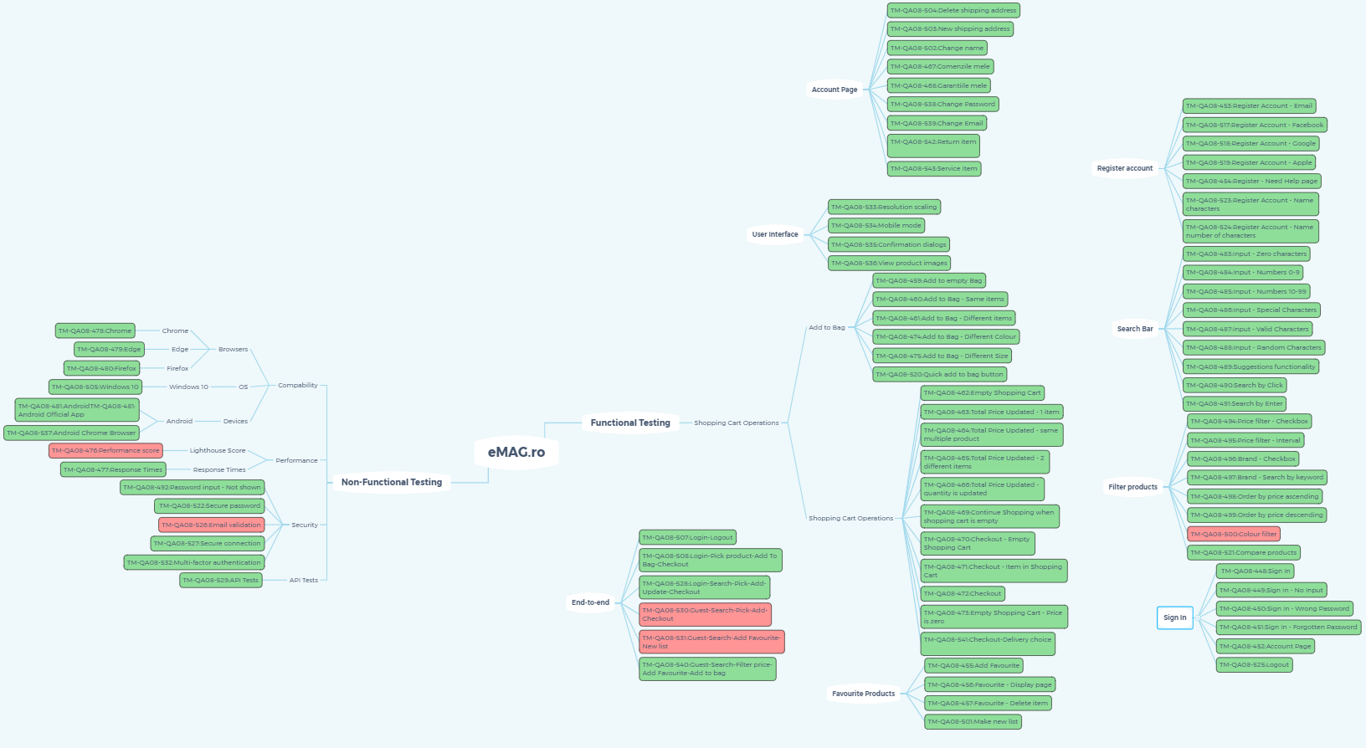
Test Cases
Site mind map→ link
Testing mind map → link

Slide 5
Summary
Summarize first topic.
Summarize second topic.

Slide 6
Questions?
Contact:
example@fedoraproject.org
License statement goes here.

